Slide 1

Year 3/4 St. Edmund

Slide 2
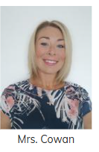
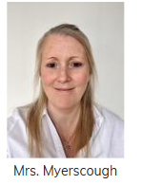
Class Teachers:
Miss Jackson
Teaching Assistants:
Mrs. Cowan
Mrs. Myerscough

Slide 3
Curriculum Maps/ Knowledge Organisers
Each half term, you will be sent home knowledge organisers and a curriculum map.

Slide 4
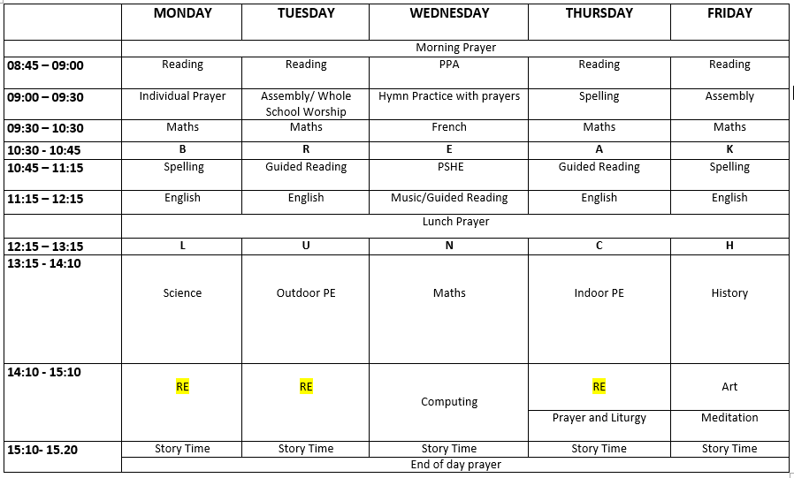
Timetable

Slide 5
Prayer and Liturgy
4-part worship, individual prayer, meditation, mass in church.
Invitations for ‘Stay and Pray’ sessions will be sent out throughout the year.
These sessions will last no longer than 10 minutes and will always be at either the beginning or the end of the day.
Class mass – all welcome.

Slide 6
Behaviour
High expectations for behaviour
Four behaviour values
Traffic light system
Communication with parents

Slide 7
Uniform
Please ensure all uniform is clearly labelled with your child’s name
No earrings
Long hair to be tied back
PE kit (no branded items)

Slide 8




Learning at Home/ Online Learning Tools
Homework is set once weekly (Friday) and children are rewarded in class for completing it.
Children have the option to change their reading book on a Friday.
Children to read at home as much as possible and please sign reading diary once the book is complete.
TT Rockstars and other learning platforms.

Slide 9

Reading
Home reading
Reading for pleasure
Guided reading
Class novel (Daily)
Library
In Year 3/4 we are developing stamina as a reader and accessing a wide range of authors and texts.
Regular reading helps to develop vocabulary, improve spellings and the ability to read at pace and with understanding.

Slide 10
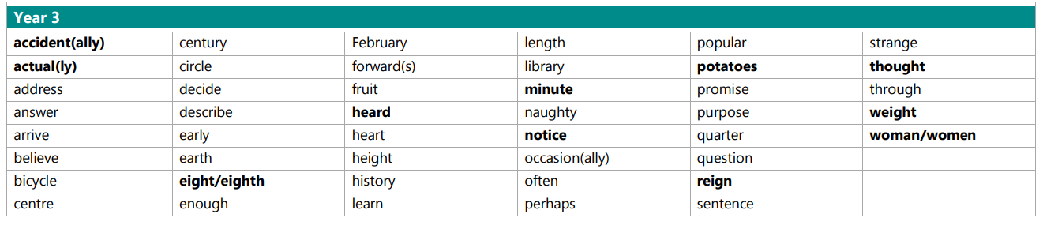
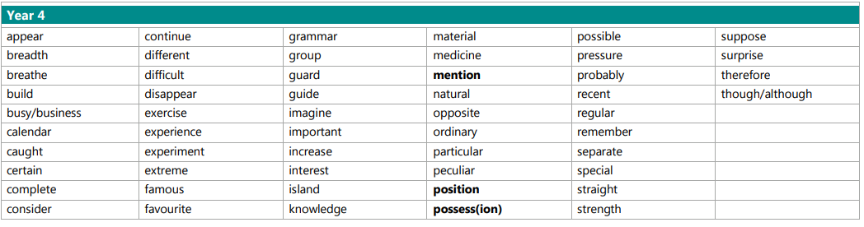
Spelling
We focus on a different spelling rule each week.

Slide 11

Maths – White Rose
We follow the White Rose scheme of Maths throughout school.
In Year 3 & 4, we will be supplementing our lessons with extra resources from Testbase.
The children have the White Rose work books in school and use jotters alongside these for any working out or extra calculations.
https://www.st-teresas-penwortham.lancs.sch.uk/mathematics/

Slide 12
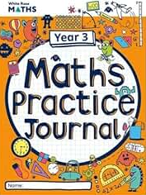

White Rose have also produced Practice Journals which are fully aligned to the curriculum we follow in school. These may be useful as an additional resource to use at home – these are not compulsory but are great for extra consolidation. They can be purchased from Amazon.

Slide 13

Communication - Seesaw
Any urgent messages, please go through the school office.

Slide 14
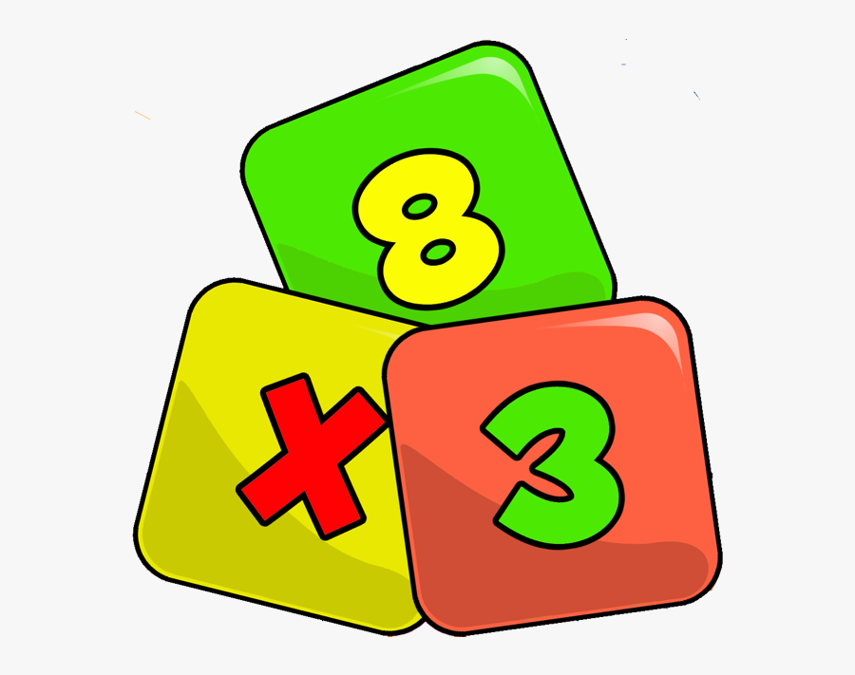
Times Tables Check - June 2026
The Multiplication Times Tables Check is an online test where the pupils are asked 25 questions on times tables 2 to 12.
For every question, the children have 6 seconds to answer, and in between the questions, there is a 3-second rest.
Questions about the 6, 7, 8, 9, and 12 times table come up more often.
The questions are generated randomly based on the rules of the MTC.
https://www.timestables.co.uk/multiplication-tables-check/

Slide 15



Things to Look Forward To…
Swimming
Holy Communion (Year 4)
Parents Evening End of Jan
Christmas Carol Service - date TBC
School trips

Slide 16

Always Working together
  We would like to thank you for your continued support!

