Slide 1
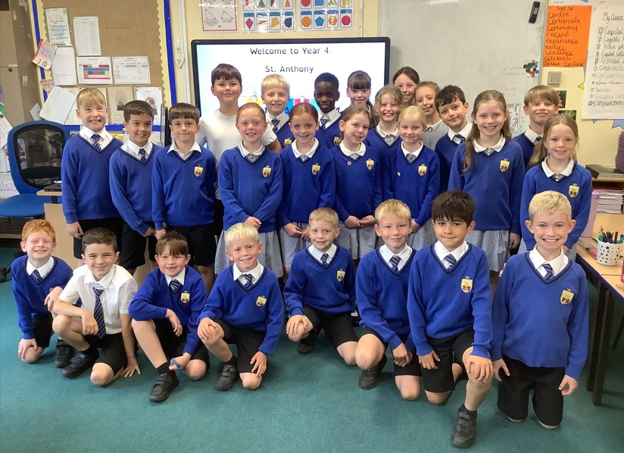
Year 4- St. Anthony

Slide 2
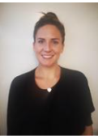
Class Teachers
Mr. Barnes: Monday
Mrs. Balazs: Tues- Fri

Slide 3
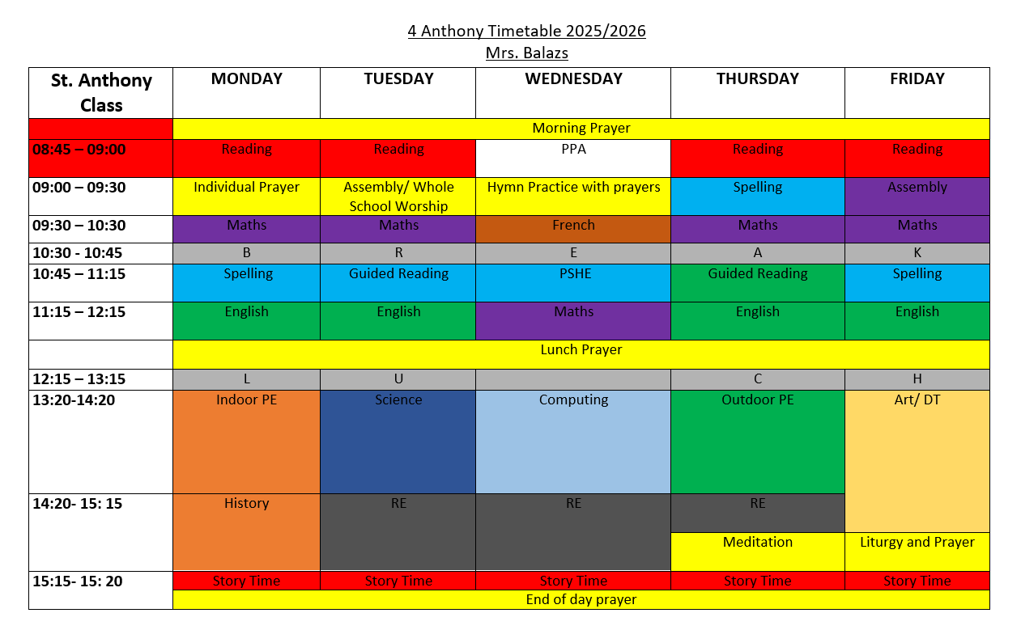

Slide 4
Curriculum maps & knowledge organisers
Each half term you will be sent home a curriculum map and knowledge organisers.

Slide 5

Reading in Year 4
Home reading- book change: Thursday
Library book can be changed weekly
Reading Plus (login details will be sent home)
Lots of reading opportunities through other subjects
In Year 4 we are developing stamina as a reader and accessing a wide range of authors and texts.
Regular reading helps to develop vocabulary, improve spellings and the ability to read at pace and with understanding.
Please encourage reading at home. Children can earn house points or Dojos for reading at home.

Slide 6

Maths – White Rose
We follow the White Rose scheme of maths throughout school.
In year 3 & 4 we will be supplementing our lessons with extra resources for challenge.
The children have the White Rose work books in school and use jotters alongside these for any working out or extra calculations.
https://www.st-teresas-penwortham.lancs.sch.uk/mathematics/

Slide 7

Times tables check- June 2026
The Multiplication Times Tables Check is an online test where the pupils are asked 25 questions on times tables 2 to 12.
For every question, the children have 6 seconds to answer, and in between the questions, there is a 3-second rest.
Questions about the 6, 7, 8, 9, and 12 times table come up more often.
The questions are generated randomly based on the rules of the MTC.
TT Rockstars – short session each morning, please encourage home use
Emile
https://www.timestables.co.uk/multiplication-tables-check/

Slide 8
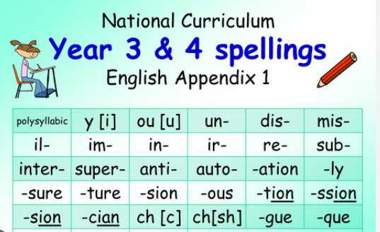
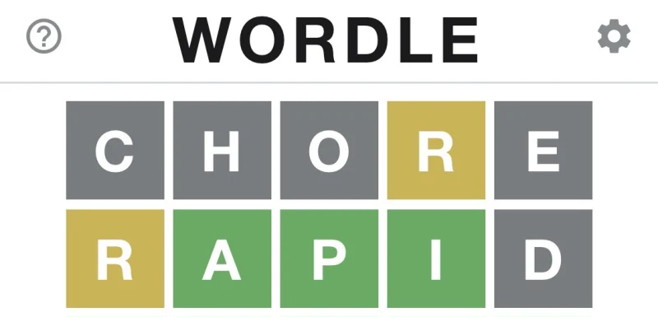
Spelling
New spelling rule each week
In lesson focus- no home spelling tests
Children should learn the Year 3/4 spelling list at home- please find this on our class webpage/reading record.

Slide 9



Homework:
Homework is set once weekly (Friday)
Children rewarded in class for completing homework
We use a variety of online platforms

Slide 10


Behaviour incentives:
House points
Class Dojo
Star Writer
Medal Winner

Slide 11

Communication- Seesaw
Any urgent messages, please go through the school office.
Please use this platform to:
Send me a direct message to ask a non- urgent question or share non- urgent information
Send homework
See updates on your child’s learning

Slide 12
Stay and Pray

Slide 13

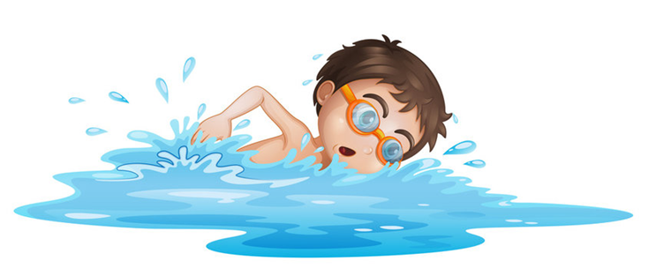

Things to look forward to…
Swimming- spring term
Holy Communion- Summer term
Parents Evening End of Jan
Christmas carol service date TBC
School Trip- Tatton Park in Chester ( Stone Age link)

Slide 14


Working together
  We would like to thank you for your continued support. Feel free to ask any questions.

