Slide 1
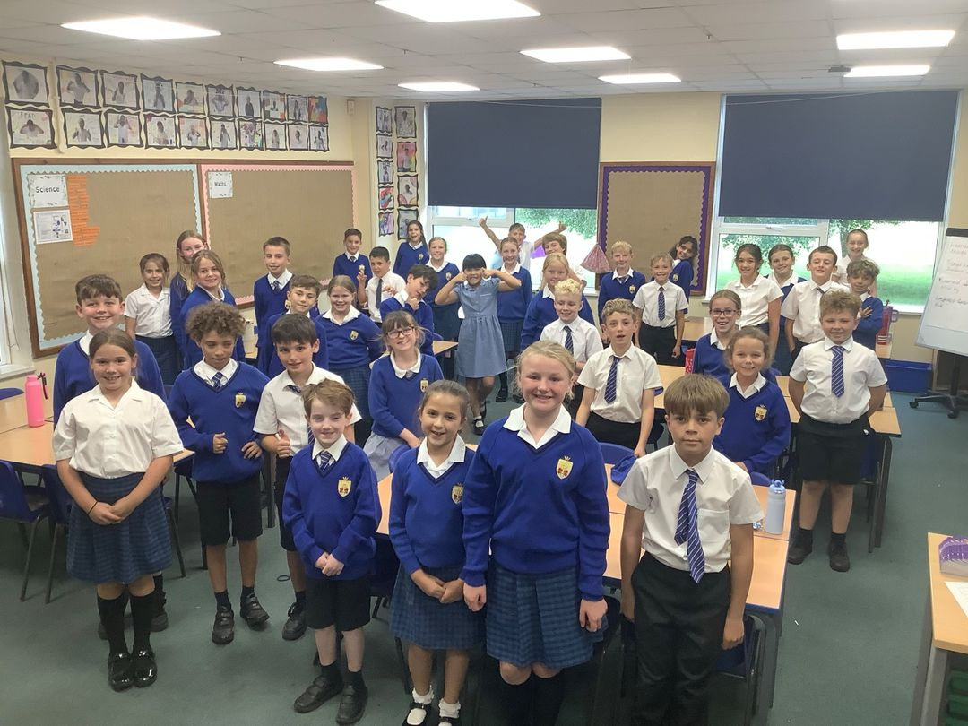
Welcome to 5 Augustine

Slide 2
Mornings in Y5
Morning groupings
RE
Maths
English
Prayer & Liturgy

Slide 3
Afternoons in Y5
All of the Year 5 and Year 6 cohorts have been split into 3 equal sized teaching groups.
Timetable - consistency
Teaching teams merge
Subjects taught in the afternoon are the same each week

Slide 4

Seesaw app
We will reply to seesaws as soon as possible but please be aware that we may not read messages until lunchtime or after the school day.
If you have any urgent messages, please send straight to the office who will pass on any information.
Homework messages will go on the seesaw group journal each week. Any photographs will also be uploaded to the journal.
If you have any issues with logging on, please let us know.

Slide 5
Class 5 Augustine Website
St. Augustine | St Teresa's Catholic Primary School
Information regarding the Curriculum will also be available on there, such as curriculum maps and knowledge organisers. ☺

Slide 6

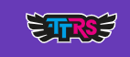
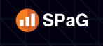

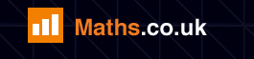
Homework – online platforms
We are monitoring these very closely - time out on Friday, if not complete.
Please let us know via seesaw if your child has trouble logging on or accessing the online homework.
We can provide time during lunch times/break times for children to complete during the school day if they can’t complete at home. There will be a homework club run by Mrs Hawitt on a Thursday lunchtime.
In addition to any set homework tasks, Reading Plus and TTRockstars are open for the children to use at any time.
All logins will be sent home in the Reading Records this week.

Slide 7
Homework – Reading
Reading is still very important in the upper juniors and we encourage the children to try and read daily at home – even if it’s just 5 or 10 minutes before bed.
If your child has a school reading book or library book, they can return it to school on any day of the week to change.
Reading Records don’t need to be signed by parents as often as in previous years, but a quick signature or comment every now and then just lets us know that you are also keeping an eye on your child’s reading.

Slide 8
Spellings
Children are given 10 spellings at the end of the week. They will have a week to learn these in school before they are tested on the following Friday.
These words will be posted on seesaw on a Friday alongside the homework.
The spelling pattern will be taught throughout the week.

Slide 9
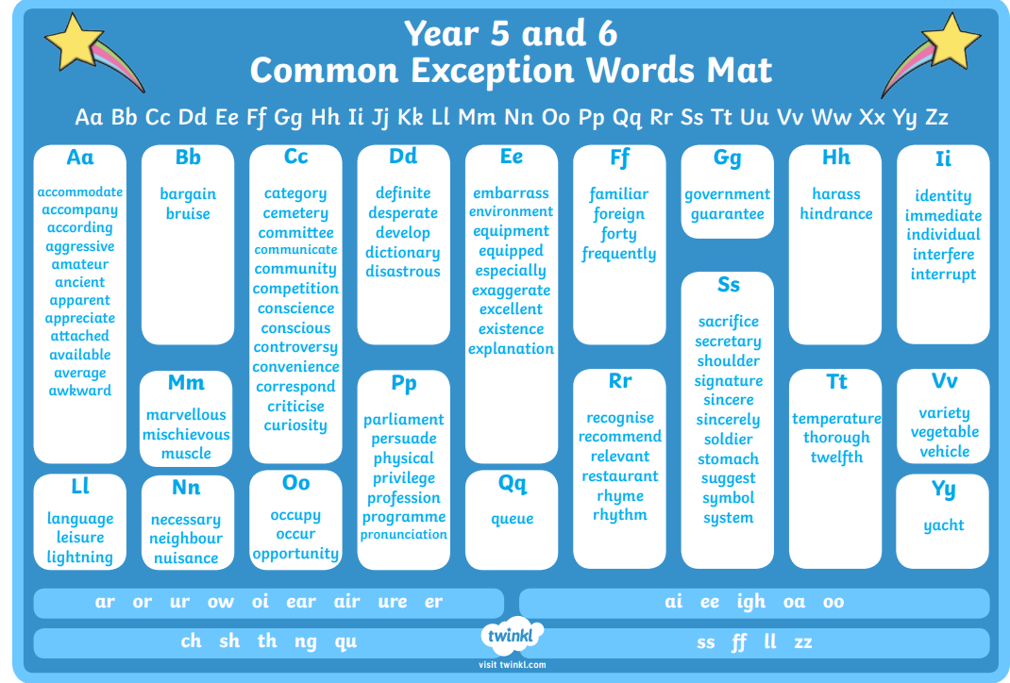
Spellings
The Year 6 word list can be found on our class website.
We also have a document which outlines all the spelling patterns and examples of words. This paper copy will be sent home with your child this week.

Slide 10
Prayer and Liturgy
4-part worship, individual prayer, meditation, mass in church.
Invitations for ‘Stay and Pray’ sessions will be sent out throughout the year.
These sessions will last no longer than 10 minutes and will always be at either the beginning or the end of the day.
Class mass – all welcome.

Slide 11
Uniform
Please ensure all uniform is clearly labelled with your child’s name
No earrings
Long hair to be tied back
PE kit (no branded items)

Slide 12
Behaviour
High expectations for behaviour
Four behaviour values
Traffic light system
Communication with parents

Slide 13
Class Governors
Our class governor’s this year are Mrs Jones and Mr Carter.
Our governors will visit us throughout the year and will be invited to special events.

Slide 14
Key Dates
Tuesday 16th September 6pm (in school) – All Hallows Y5 and Y6 presentation
Autumn term – Year 5 swimming on a Thursday beginning Thursday 11th September (no swimming lesson on Thursday 18th September due to pool closure).

Slide 15
Q & A
Any questions?

