Slide 1

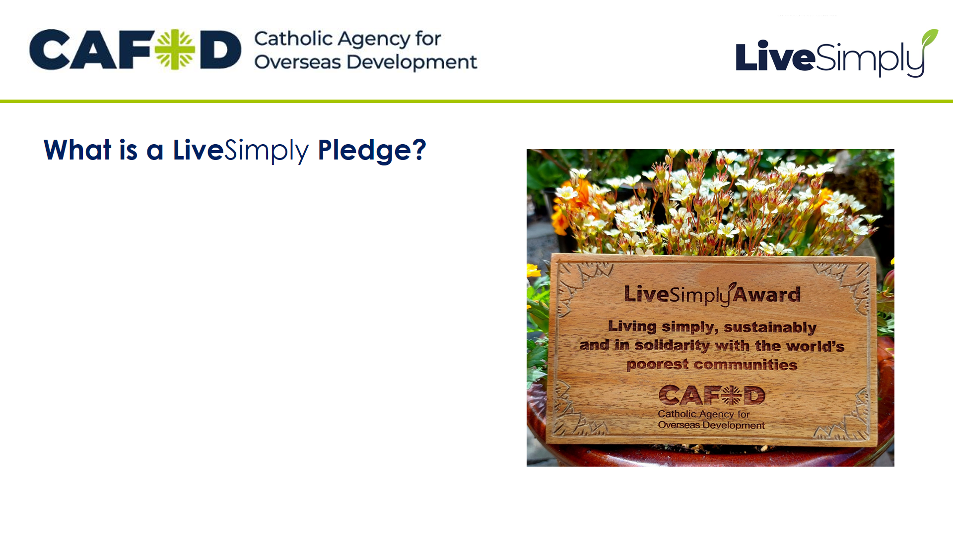

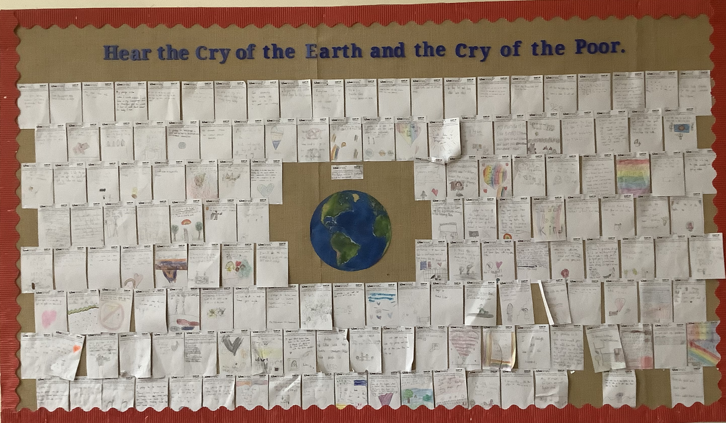

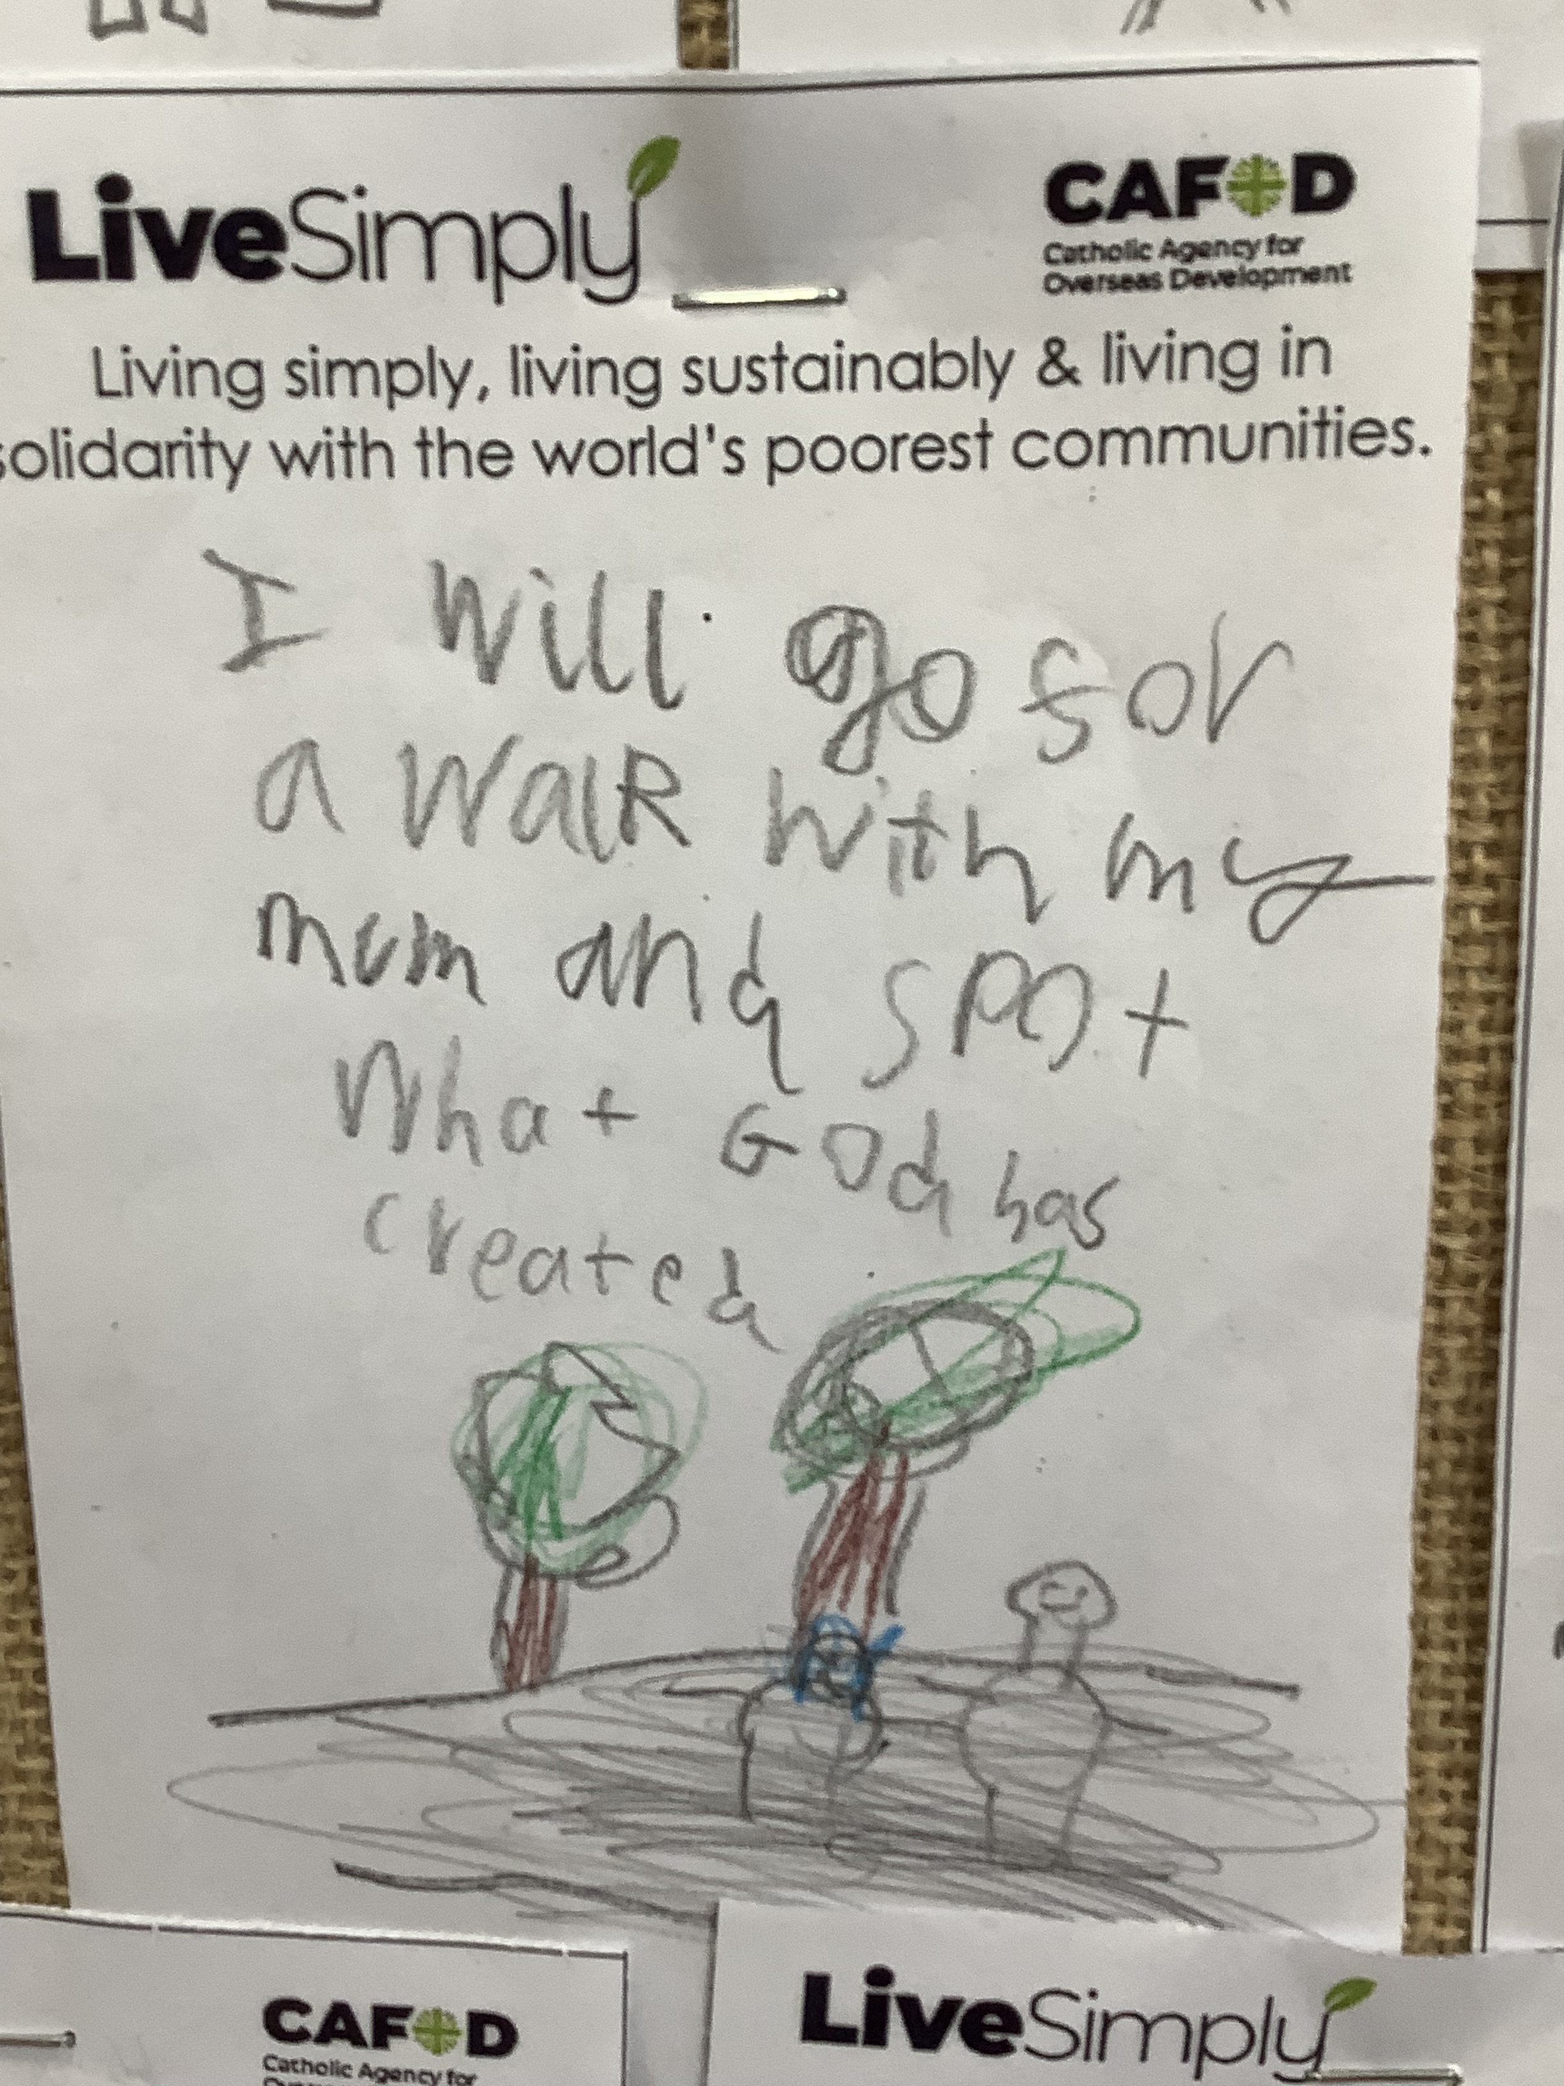
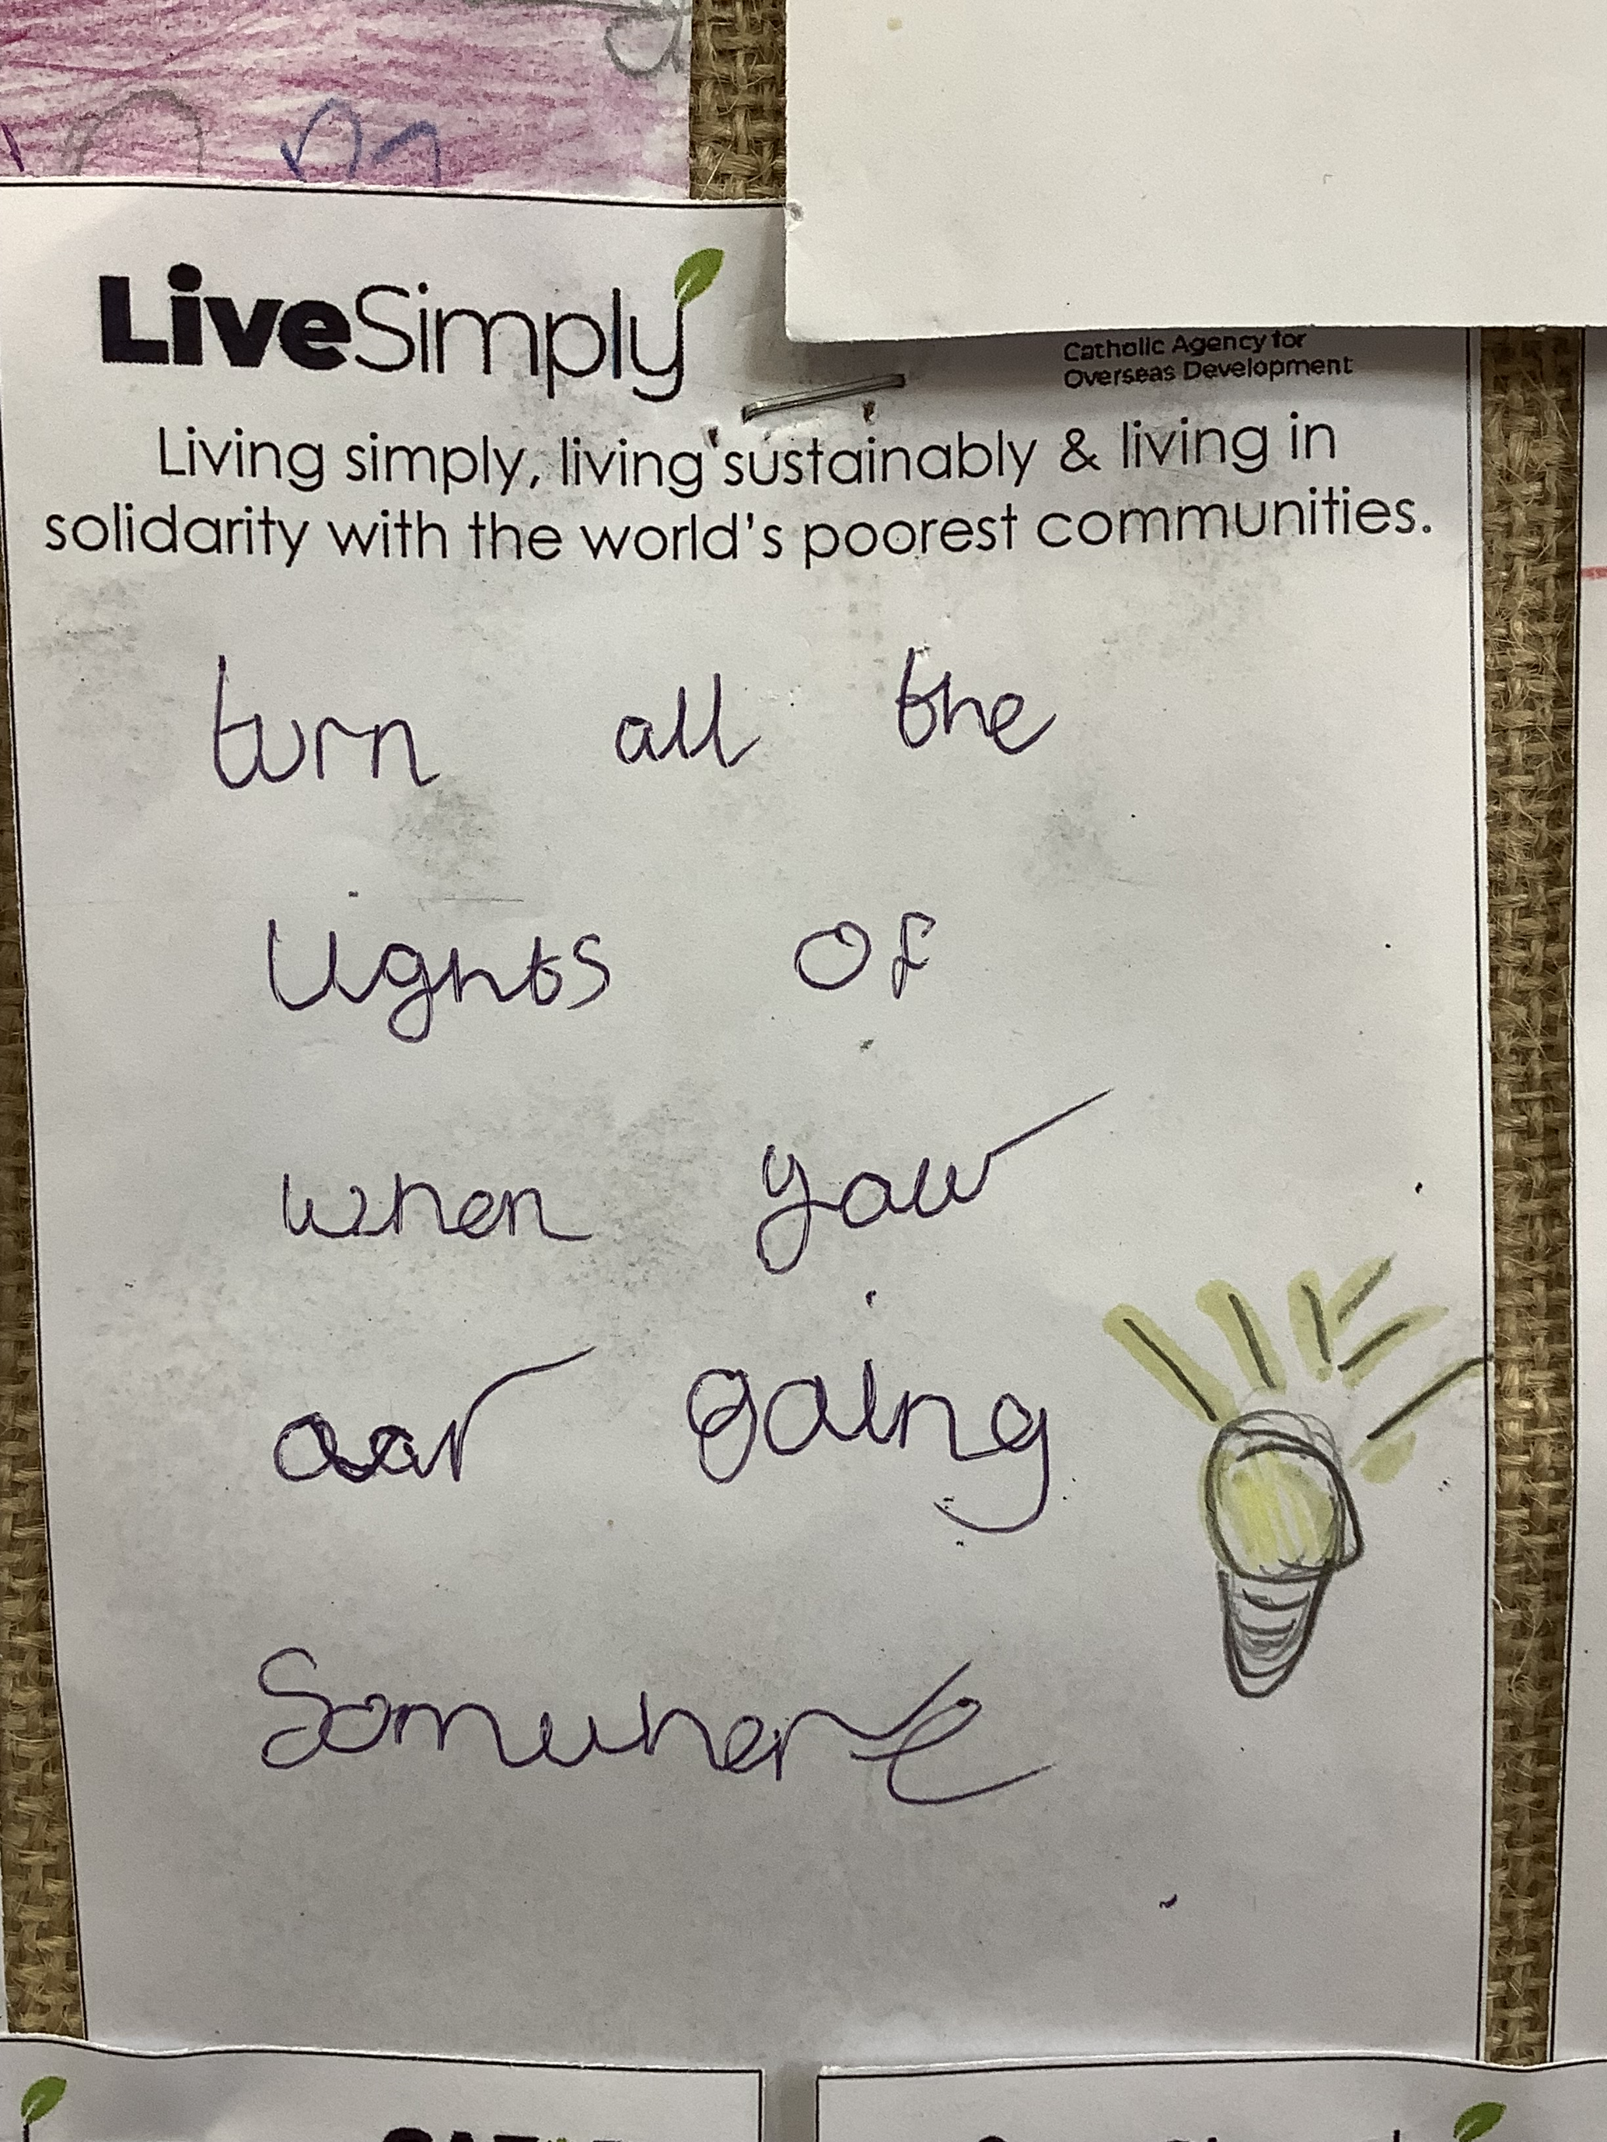
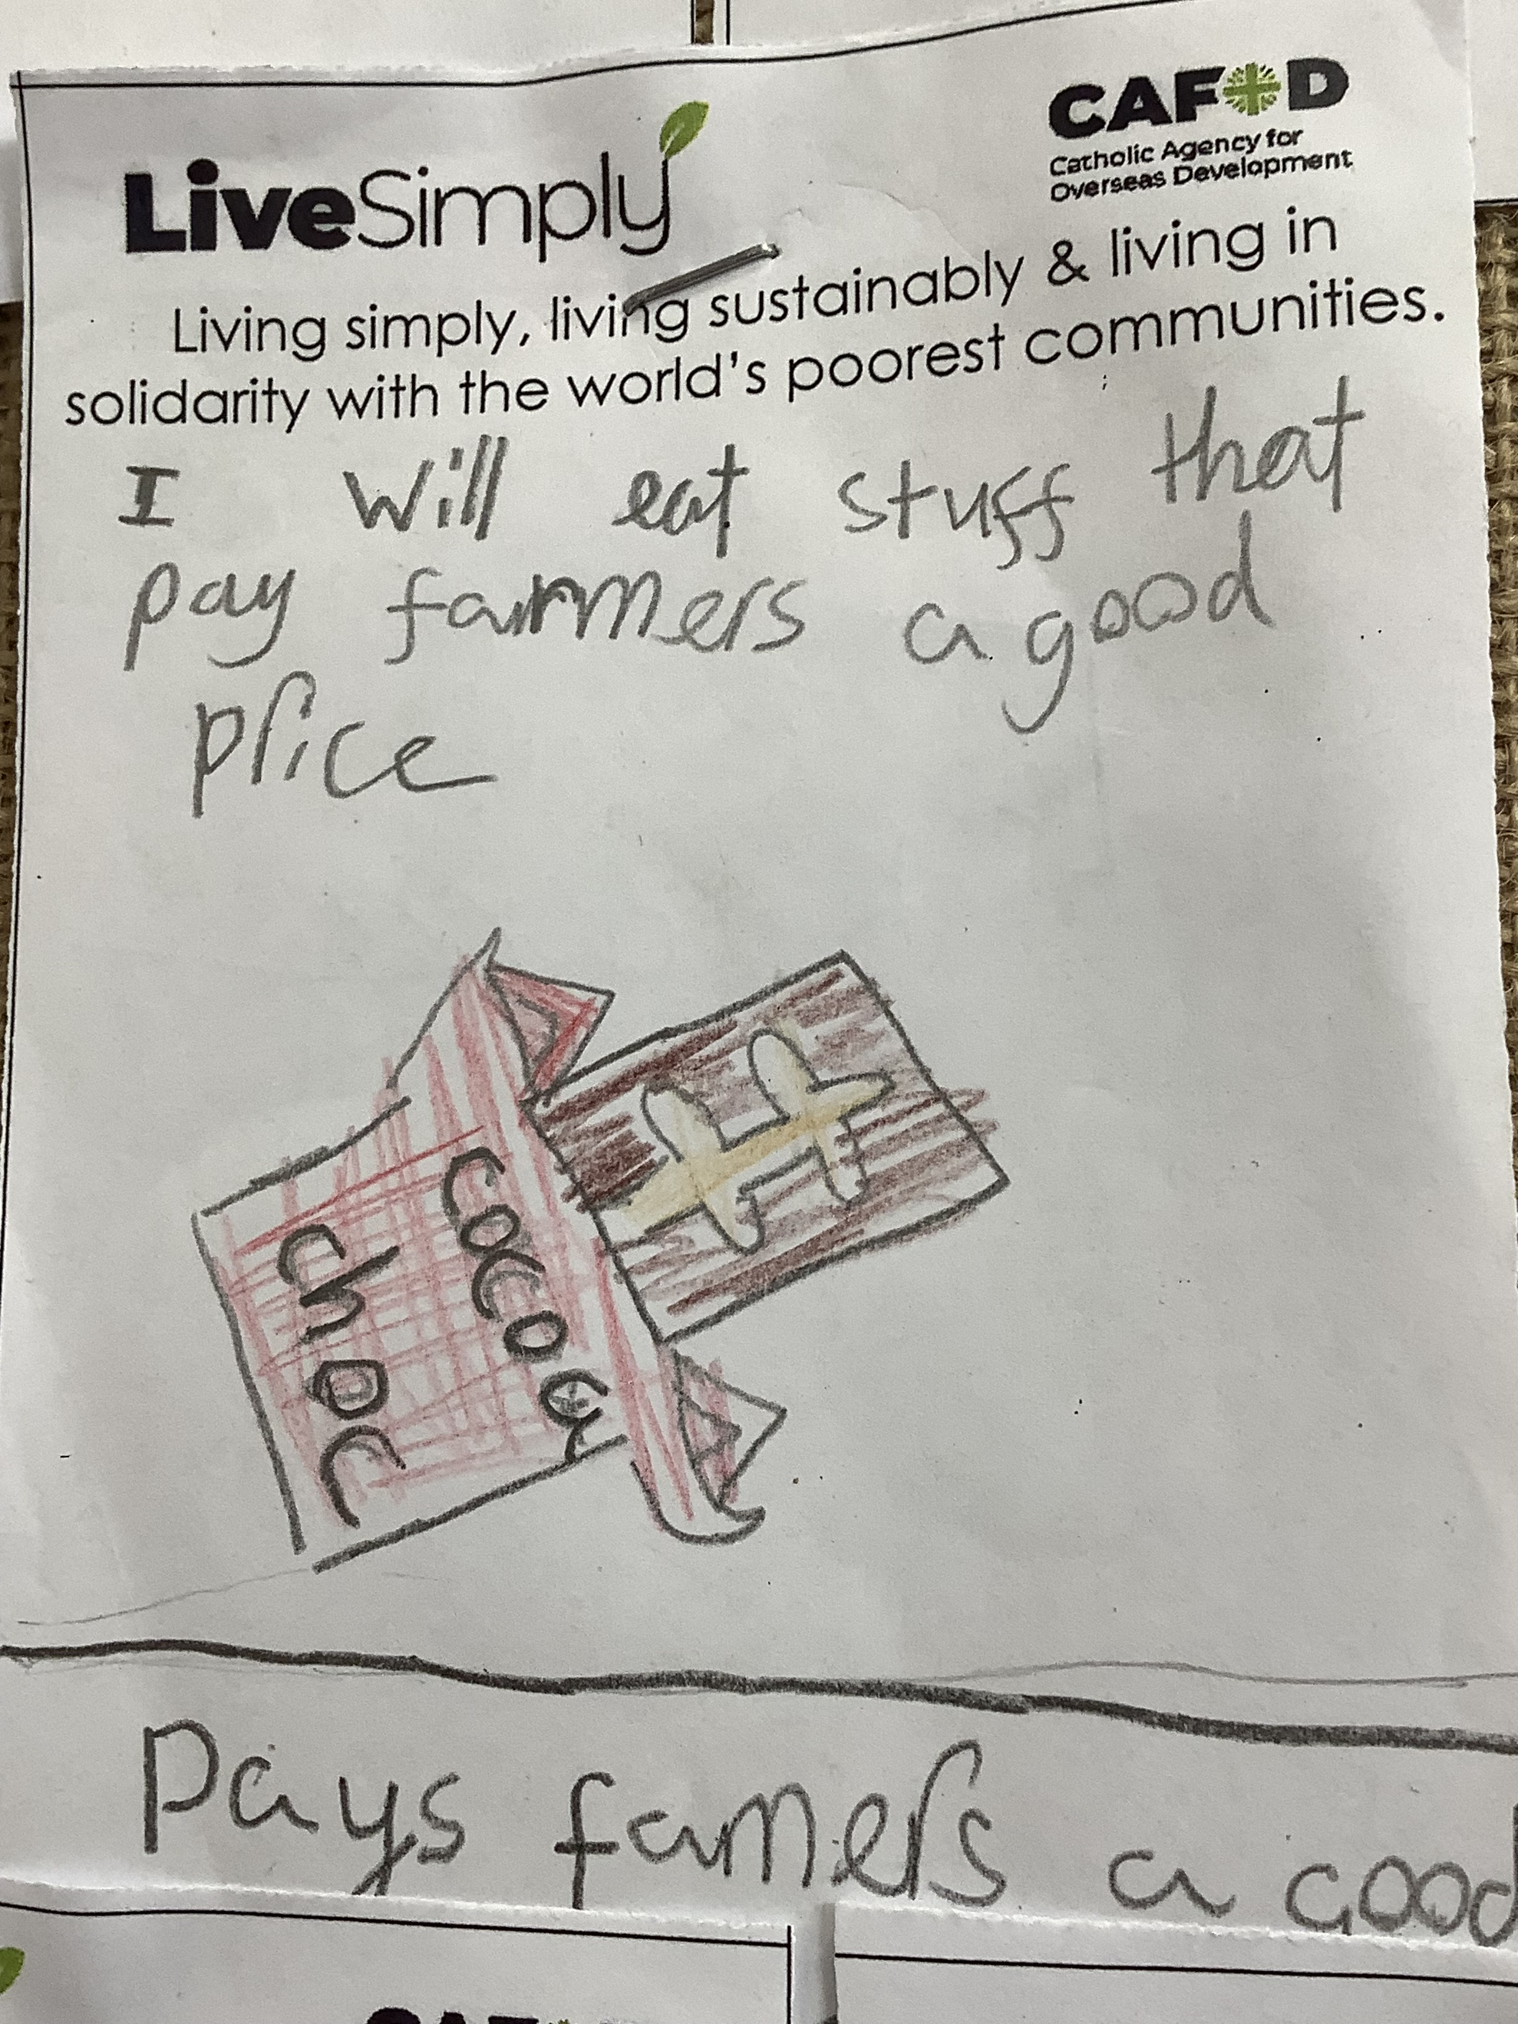

Faith Input
Hear the cry of the Earth and the cry of the poor.
We come together to take charge of this home which he has entrusted to us. Pope Francis, Laudato Si 244
Our Pledges
At the start of our Live Simply journey the whole school community made a pledge. We displayed them in the Hall
A pledge is a promise to do something.
Making a LiveSimply pledge is one of our actions
towards achieving the LiveSimply Award
and is a promise to:
live simply, live sustainably and live in solidarity
with the world’s poorest communities.
Pupil voice
It was fun to think about what God created and why.
I made my pledge to make people feel happy.

