Slide 1
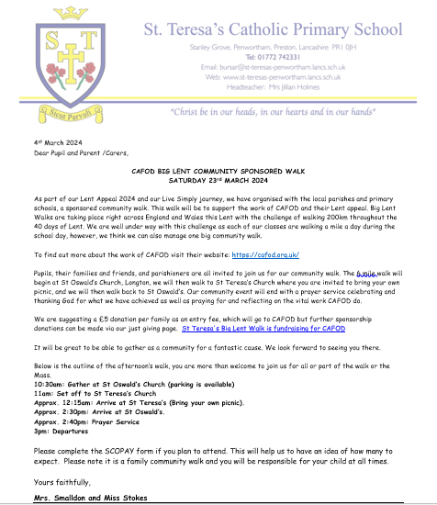

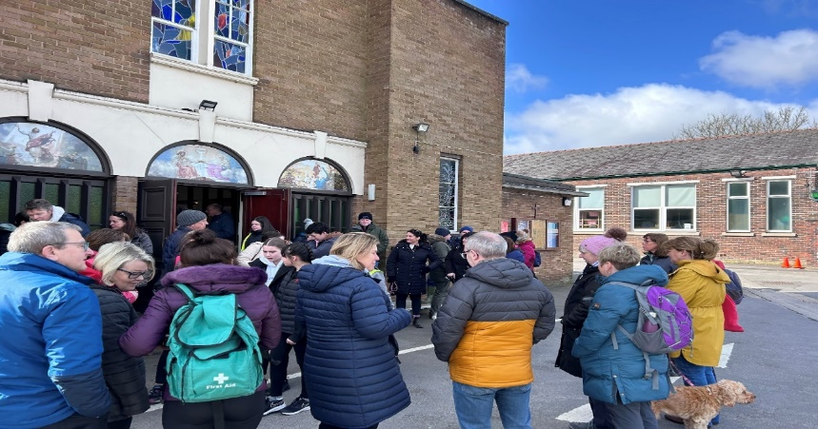


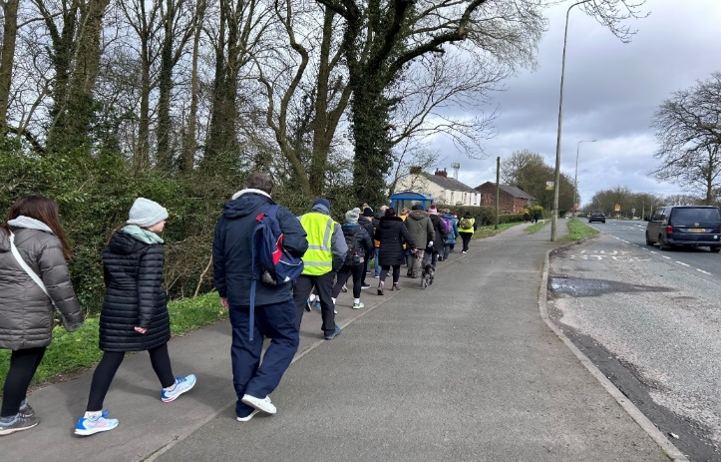
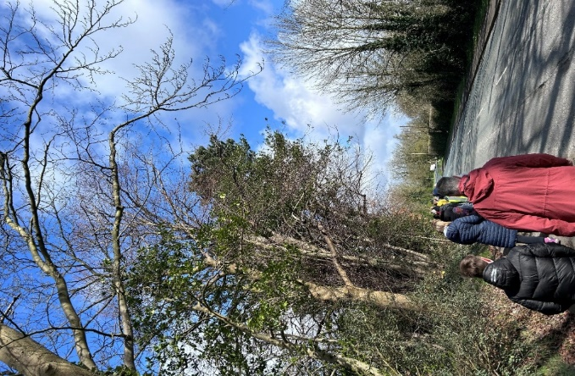

CAFOD BIG LENT WALK
Faith Input
For I was hungry and you gave me something to eat, I was thirsty and you gave me something to drink, I was a stranger and you invited me in, I needed clothes and you clothed me, I was sick and you looked after me, I was in prison and you came to visit me.’
Pupil voice
It was fun! We did it to raise money For CAFOD. I enjoyed walking with other people from different schools.
It was fun and muddy!
We worked together with the local High School and Primary School to raise money and awareness of the poor during the month of Lent.

Slide 2
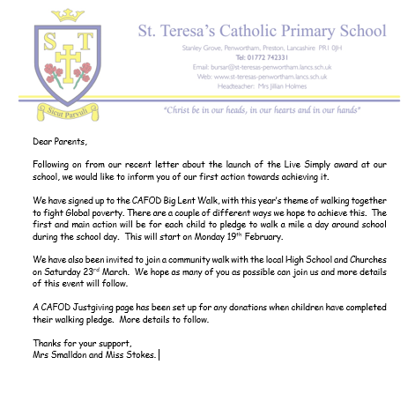
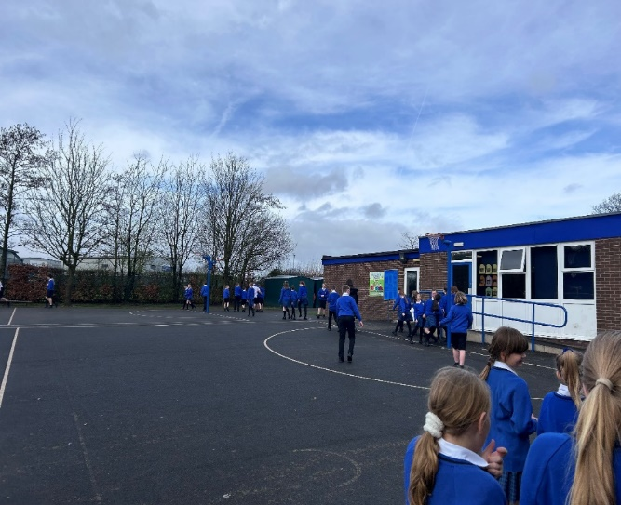
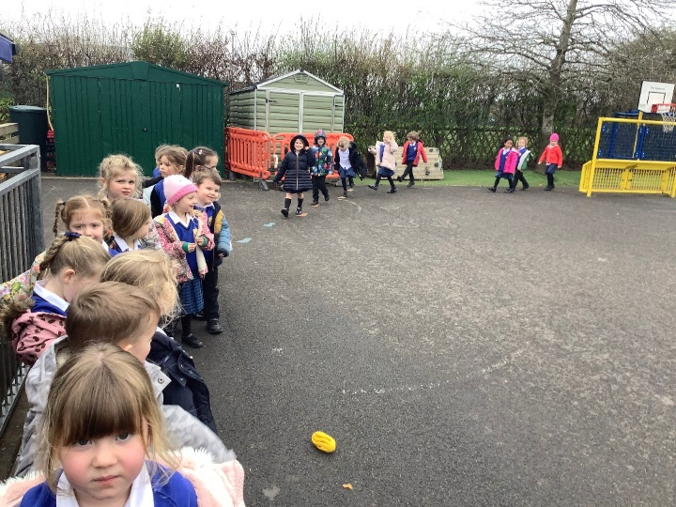
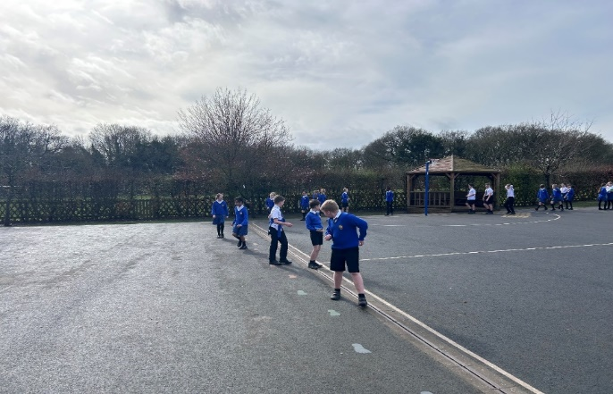
Faith Input
For I was hungry and you gave me something to eat, I was thirsty and you gave me something to drink, I was a stranger and you invited me in, I needed clothes and you clothed me, I was sick and you looked after me, I was in prison and you came to visit me.’
Pupil voice
I enjoyed it, we got fresh air and we had chance to talk to our friends. It also helped us to be aware of those less fortunate than ourselves.

