Slide 1

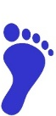

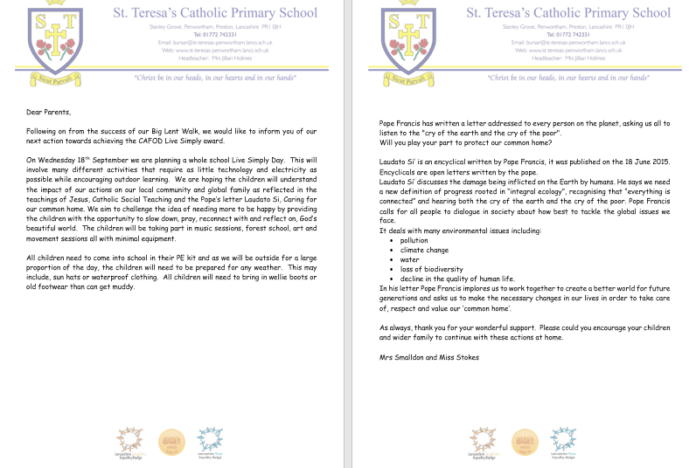

Faith Input
CST -The common good means that the fruits of the earth belong to everyone. No one should be excluded from the gifts of creation.
Live Simply Day
We started our Live simply day with no lights on in school and without the use of our white boards in class. The morning started with a worship using only the piano and candles.
The children worked on four different areas with the emphasis on only using natural resources available to us.
The children worked with music, movement, forest school, and craft.
Pupil voice
It was fun, everyone enjoyed it.
It was nice to get outside and create stuff with others.
Loving God,
You made this beautiful world that we all share.
Help us to live simply and be thankful for all you have given us.
Help us to look after our earth so that everyone may enjoy it.
Help us to share with others, so that everyone has what they need.
Amen

Slide 2
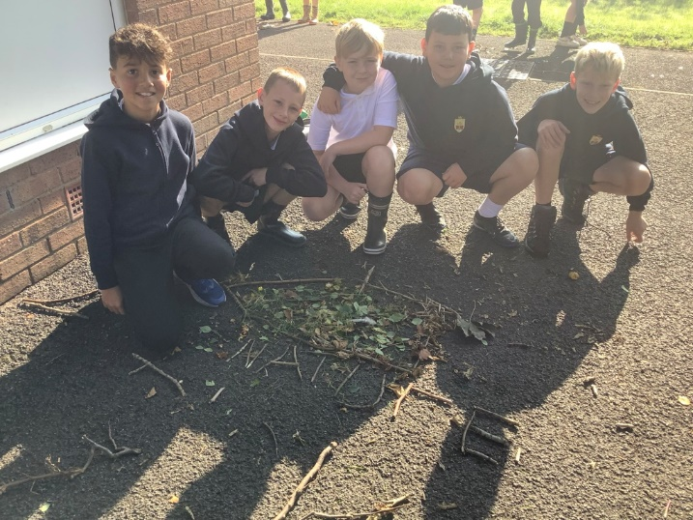
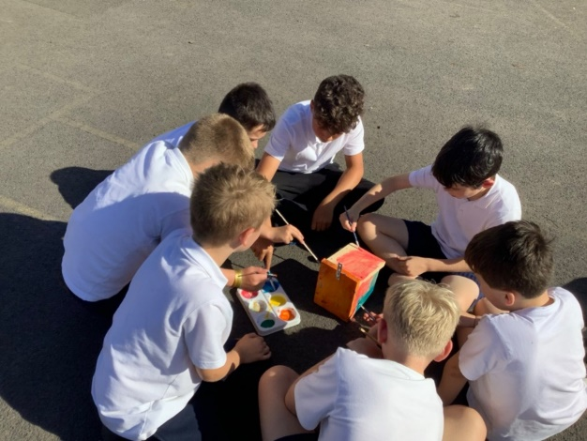
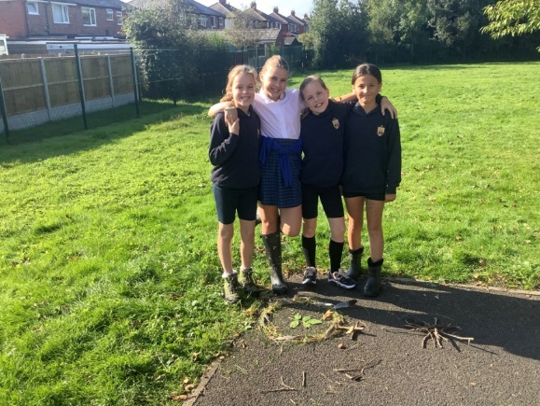
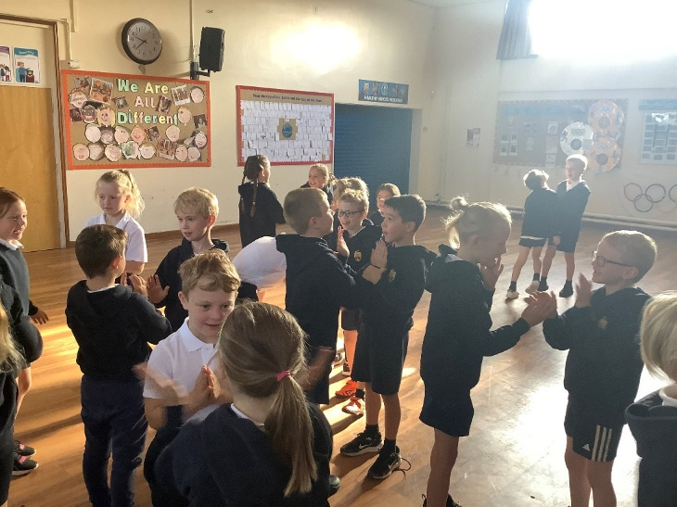
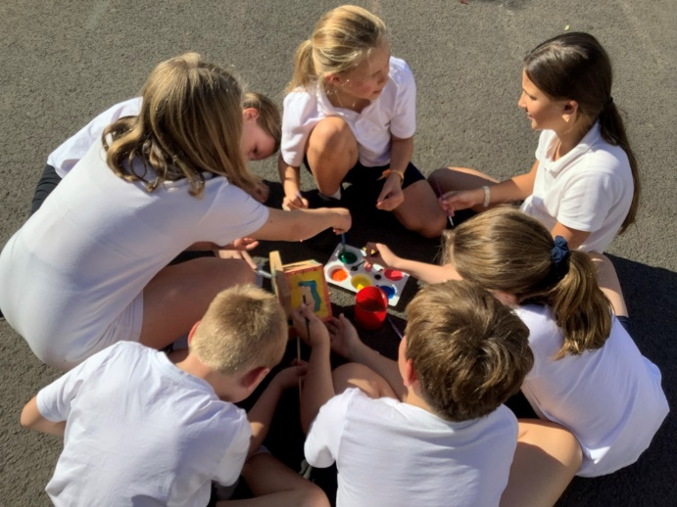
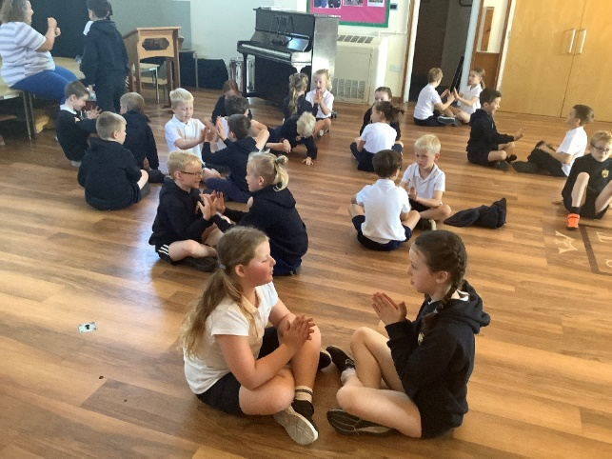
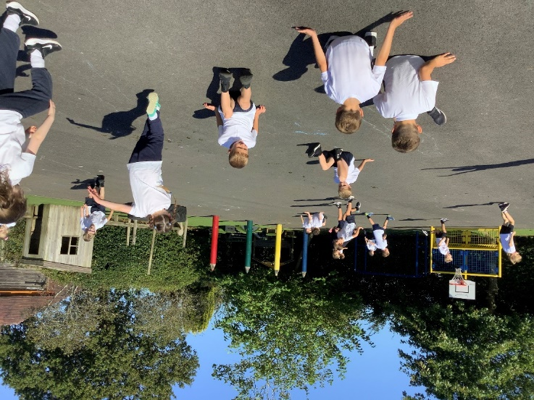
Faith Input
CST -The common good means that the fruits of the earth belong to everyone. No one should be excluded from the gifts of creation.
Pupil voice
It gave us a break from electronics and showed us we don’t need to waste electricity.

Slide 3
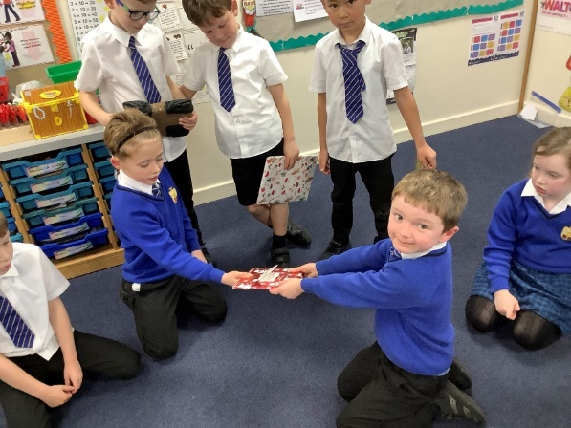
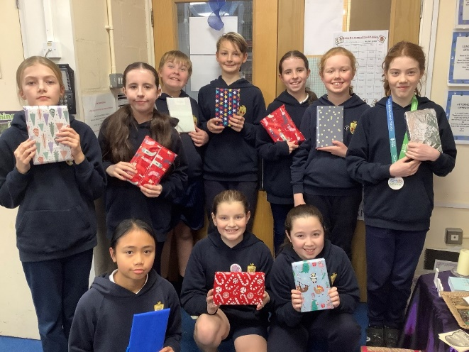
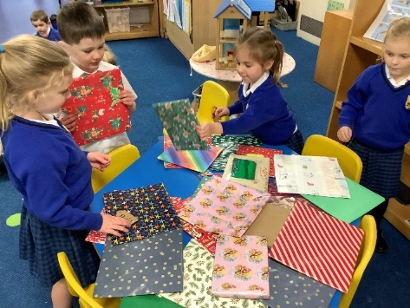
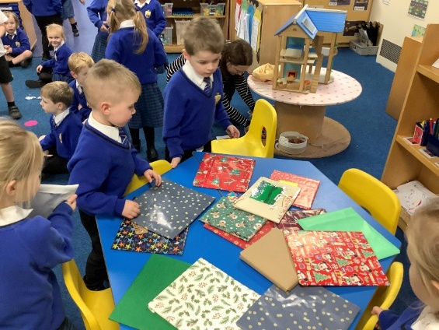
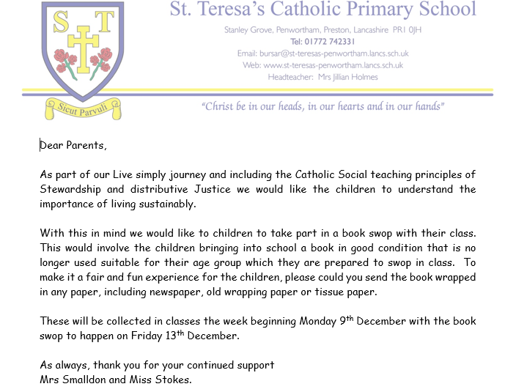
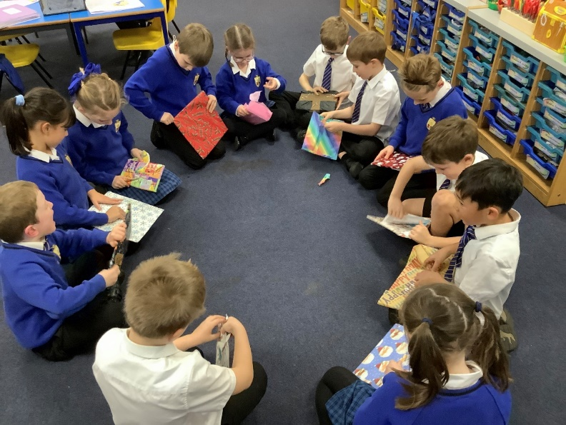
St Teresa's Book swop

