Slide 1
Loving our neighbour is loving Jesus

Slide 2
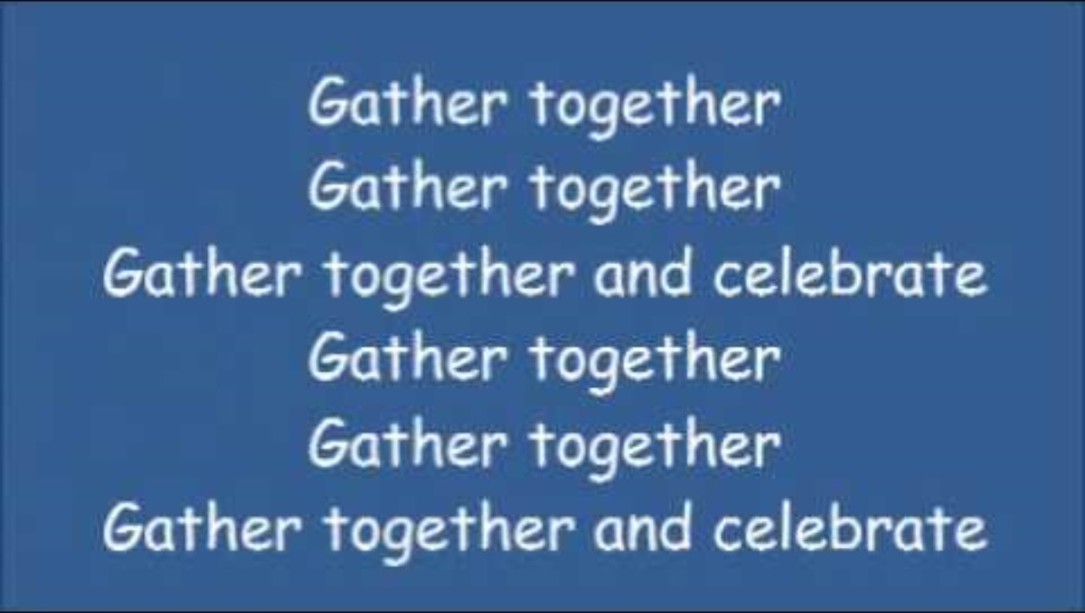
Gather
Make the sign of the cross, be still, be present
Gather Together

Slide 3
Gather
Jesus Christ, light of the world
All: Shine brightly in our hearts
Jesus Christ, God’s loving word
All: Help us to listen to your voice
Jesus Christ, saviour of the world
All: Thank you for your love.

Slide 4
Word
Be attentive – Wisdom has spoken
The Lord be with you
All – And with your spirit
A reading from the holy Gospel according to:
John (13:1-17)
All – Glory to you O Lord
(Forehead, lips and heart)
The Gospel of the Lord
All – Praise to you Lord Jesus Christ.

Slide 5
Response
The response is: Loving my neighbour is loving you, Lord.
Lord, you created each one of us in your image and likeness. You love us all equally; help us to recognise that we are your cherished and beloved children and that each one of us is deserving of your love.
Response
Lord, you teach us that loving our neighbour goes beyond the boundaries of loving those nearest to us. Help us to see our neighbour in those who are far away, in the stranger, the marginalised, the disadvantaged, the poor and vulnerable.
Response
We are stewards of the earth, the builders of your kingdom. We are called to love, care and take responsibility for all of your creation.
Response

Slide 6
Go forth
Let’s say the concluding prayer together:
Jesus, You taught us that love is far more than an emotion or feeling.
Love is an action.
Help us to be humble instruments of your love in all that we do.
Let others experience your love in the world through our service.
Amen

Slide 7
Go forth
John Burland - Jesus Light of the World (Official Lyric Video)

Slide 8
Dismissal
We will finish with our Mission statement
St. Ignatius
All – pray for us
St. Teresa
All – pray for us

Slide 9
Take away
Write a prayer inside the foot template.
Add it to our prayer wall.

