Slide 1
Our active love builds the kingdom of God

Slide 2
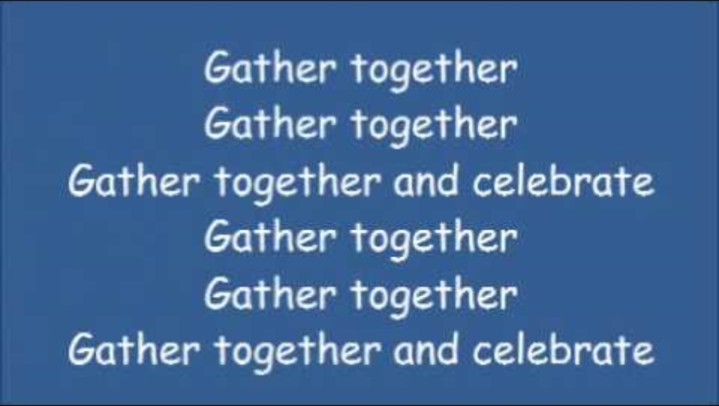
Gather
Make the sign of the cross, be still, be present
Gather Together

Slide 3
Gather
Jesus Christ, light of the world
All: Shine brightly in our hearts
Jesus Christ, God’s loving word
All: Help us to listen to your voice
Jesus Christ, saviour of the world
All: Thank you for your love.

Slide 4
Word
Be attentive – Wisdom has spoken
The Lord be with you
All – And with your spirit
A reading from the holy Gospel according to:
Matthew (5:16)
All – Glory to you O Lord
(Forehead, lips and heart)
The Gospel of the Lord
All – Praise to you Lord Jesus Christ.

Slide 5
Response
Pass the candle around the circle
https://www.youtube.com/watch?v=qibAAo0JiEQ

Slide 6
Go forth
Let’s say the concluding prayer together:
Jesus, you are the light of the world, Bringing joy, hope, and peace, and dispelling all despair and darkness.
Shine in my heart.
Help me to turn away from darkness.
Let me bring your light to those who are afraid, alone, and lost.
Light my path, so that I can remain close to you always,
As a witness to your light and your love.
Amen.

Slide 7
Dismissal
We will finish with our Mission statement
St. Ignatius
All – pray for us
St. Teresa
All – pray for us

Slide 8
Take away
How will you shine your light?
Share your light with someone at home.

