Slide 1
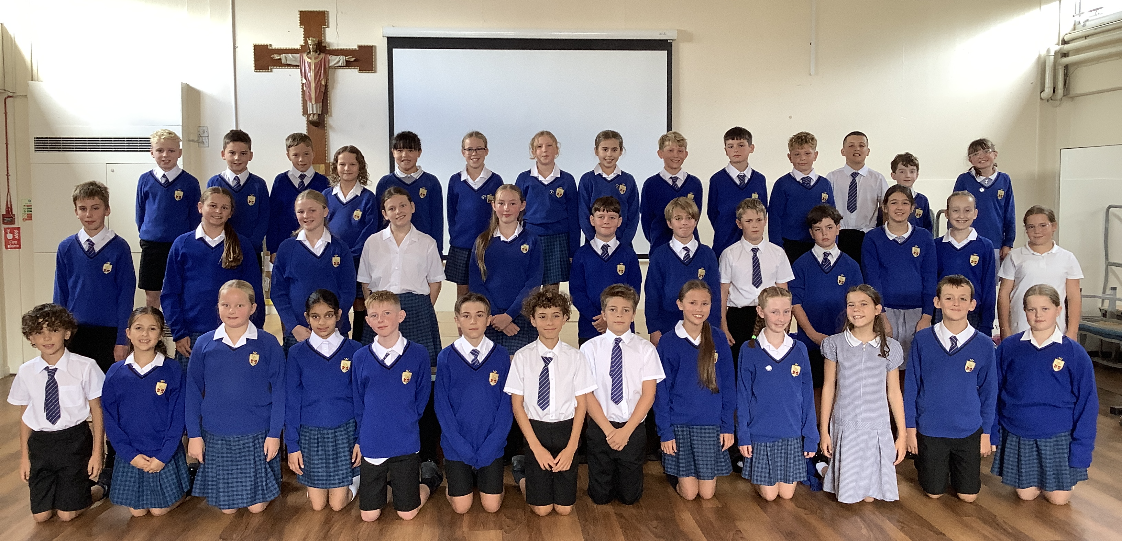
Welcome to 6 Ignatius

Slide 2
Mornings in Y6
Morning groupings
RE
Maths
English
Prayer & Liturgy
PE (Thursday)

Slide 3
Afternoons in Y6
All of the Year 5 and Year 6 cohorts have been split into 3 equal sized teaching groups.
Timetable – consistency
Teaching teams merge

Slide 4

Seesaw app
We will reply to seesaws as soon as possible but please be aware that we may not read messages until lunchtime or after the school day.
If you have any urgent messages, please send straight to the office who will pass on any information.
Homework messages will go on the seesaw group journal each week. Any photographs will also be uploaded to the journal.
If you have any issues with logging on, please let us know.

Slide 5

Class 6 Ignatius Website
St. Ignatius | St Teresa's Catholic Primary School
https://www.st-teresas-penwortham.lancs.sch.uk/st-ignatius/
Information regarding the Curriculum will also be available on there, such as curriculum maps and knowledge organisers. ☺

Slide 6

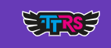
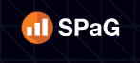

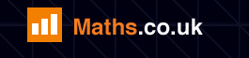
Homework – online platforms
We are monitoring these very closely - time out on Friday, if not complete.
Please let us know via seesaw if your child has trouble logging on or accessing the online homework.
We can provide time during lunch times/break times for children to complete during the school day if they can’t complete at home. There will be a homework club run by Mrs Hawitt on a Thursday lunchtime.
In addition to any set homework tasks, Reading Plus and TTRockstars are open for the children to use at any time.
All logins will be sent home in the Reading Records this week.

Slide 7
Homework – Reading
Reading is still very important in the upper juniors and we encourage the children to try and read daily at home – even if it’s just 5 or 10 minutes before bed.
If your child has a school reading book or library book, they can return it to school on any day of the week to change.
Reading Records don’t need to be signed by parents as often as in previous years, but a quick signature or comment every now and then just lets us know that you are also keeping an eye on your child’s reading.

Slide 8
Spellings
Children are given 10 spellings at the end of the week. They will have a week to learn these in school before they are tested on the following Friday.
These words will be posted on seesaw on a Friday alongside the homework.
The spelling pattern will be taught throughout the week.

Slide 9

Spellings
The Year 6 word list will be on our class website.
We also have a document which outlines all the spelling patterns and examples of words. This paper copy will be sent home this evening.

Slide 10
Year 6 SATS
SATs week is the week beginning Monday 10th May 2027.
There will be a Year 6 parents meeting regarding SATS on Tuesday 12th January. A letter will be sent nearer the time.
As the year progresses, interventions will take place for the children who will benefit from them.

Slide 11
Prayer and Liturgy
4-part worship, individual prayer, meditation, mass in church.
Invitations for ‘Stay and Pray’ sessions will be sent out throughout the year.
These sessions will last no longer than 10 minutes and will always be at either the beginning or the end of the day.
Class mass – all welcome.

Slide 12
Uniform
Please ensure all uniform is clearly labelled with your child’s name
No earrings
Long hair to be tied back
PE kit (no branded items)

Slide 13

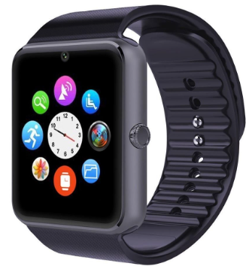
Mobile phones and smart watches
Pupils in Key Stage 2 may bring a mobile phone, smart watch or electronic device to school where this is needed before or after the school day. Before entering the school premises, all such devices must be switched off and handed to the class teacher, where they will be stored securely until the end of the school day.
Smart watches capable of making calls, sending or receiving messages, accessing the internet, taking photographs, making recordings or tracking location are subject to the same requirements as mobile phones.
While the school will take reasonable steps to ensure that devices are stored securely, they are brought onto the school site at the owner's risk and the school cannot accept responsibility for any loss, theft or damage.

Slide 14
Mobile phones and smart watches
Exceptions
Where a parent or carer believes there is a genuine need for their child to have access to a mobile phone, smart watch or other electronic communication device during the school day, they should submit a written request to the Headteacher outlining the reasons for this request.
The Headteacher will consider each request on an individual basis and will determine whether an exception to this policy is appropriate. Any agreed arrangements will be documented and reviewed as necessary.

Slide 15
Behaviour
High expectations for behaviour
Four behaviour values
Traffic light system
Communication with parents

Slide 16
Class Governor
Our class governor this year is Mrs Jones.
Our governor will visit us throughout the year and will be invited to special events.

Slide 17
Supporting Allergy Safety at St Teresa’s
Anaphylaxis and Asthma
We have pupils in school with a wide range of allergies, including some children with severe, life-threatening allergies. Everyone in our school community can help us create a safe and inclusive environment for all pupils.
How Parents Can Help
Please remind your child never to share food, drinks, lunchbox items or breaktime snacks with other children. Sharing food can place children with allergies at significant risk.
Choose healthy breaktime snacks that are low in sugar and support healthy eating.
Please avoid sending products containing nuts whenever possible. While we cannot guarantee an allergen-free environment, reducing the presence of nuts helps minimise risk for pupils with severe allergies.

Slide 18
If Your Child Has an Allergy
Parents and carers are asked to:
✅ Inform the school of any diagnosed allergy, including previous serious allergic reactions, any history of anaphylaxis and details of prescribed medication.
✅ Provide copies of relevant medical documentation, Allergy Action Plans and advice from healthcare professionals.
✅ Ensure all required medication is supplied, in date and replaced before expiry.
✅ Keep the school informed of any changes to their child's allergy, treatment or management plan.

Slide 19
If your Child has Asthma
Parents and carers are asked to:
Inform the school if their child has asthma and provide up-to-date information about their condition, triggers and symptoms.
Provide a copy of the child's Asthma Action Plan, issued by the relevant healthcare professional.
Ensure their child has a prescribed reliever inhaler available at school. The inhaler must be in medical packaging with the child’s name and dosage.
Keep the school informed of any changes to medication, treatment, triggers or management plans and provide a new Asthma Action Plan for these changes.

Slide 20
Spare Emergency Medication in School Spare Adrenaline Auto-Injectors (AAIs) In line with Department for Education guidance, St Teresa's now holds spare Adrenaline Auto-Injectors (AAIs) for emergency use. These may be used for: Anyone experiencing anaphylaxis who has not previously been prescribed adrenaline. A pupil whose own adrenaline medication is unavailable, has misfired, or where an additional dose is urgently required. The school office will be seeking parental consent to administer a spare AAI to your child in a life-threatening emergency. While emergency treatment can be given without prior consent if needed to save life, obtaining consent in advance helps to avoid delays in treatment.

Slide 21
Spare Emergency Asthma Inhaler
Asthma is the most common long-term medical condition in childhood, and many children at risk of anaphylaxis also have asthma.
In line with Department of Health guidance, the school has a spare Salbutamol reliever inhaler and spacer for use in emergencies when a pupil's prescribed inhaler is not available.
A spare emergency inhaler can only be used for pupils who have already been prescribed a reliever inhaler by a healthcare professional and where parental consent has been obtained.
If the school is aware that your child has asthma, the school office will ask for your permission to use the emergency inhaler should an emergency arise.
If you have any concerns, please speak to your child’s class teacher.

Slide 22
Home time arrangements
If you have a message about home time for the same day, please contact the office as we may not see any seesaw messages.
If your child is walking or cycling home without an adult, please let the office know. It is important that we know how the children are getting home for safeguarding reasons.

Slide 23
Key Dates
Wednesday 16th September 6pm (at All Hallows) – All Hallows Y5 and Y6 presentation
Mon 28th – 30th September- Y6 Residential to Tower Wood
Thursday 8th October – Y6 Taster Day at All Hallows (more details to follow in a letter)
Tuesday 12th January 5pm – SATs meeting for parents (in school)
Week beginning 10th May – SATs week (Mon-Thurs)
Friday 16th July 9:15am – Leavers’ assembly

Slide 24
Q & A
Any questions?

