Slide 1

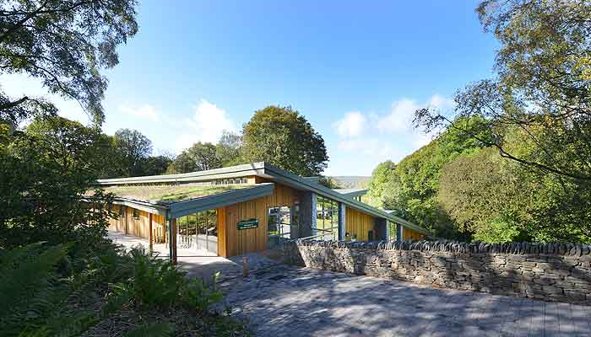
Y6 Residential 2026
Tower Wood
https://www.lancashire.gov.uk/outdooreducation/our-centres/tower-wood/

Slide 2
Travelling to and from Tower Wood
We are travelling to Tower Wood on a Redline coach. The coach will leave the Church car park at 09:30am Monday 28th September.
The children will need a packed lunch for their first day which they will eat when the arrive at Tower Wood.
Parents are more than welcome to come and wave the children off.

Slide 3
Travelling to and from Tower Wood
We will leave Tower Wood at approximately 1pm on Wednesday 30th September. The children will have their lunch at the centre before we leave.
The coach is due to arrive back to Church at approximately 3pm.

Slide 4
Contact details and medical forms
It is really important that we have your current contact details and any relevant medical information for your child. Please complete the contact details and medical forms that we have given to you. Please return these to your child’s class teacher by Wednesday 16th September.

Slide 5
Medication
If your child will be bringing medication, it is important that it is clearly marked with the child’s name and dosage. All medication (apart from inhalers) should be given to Mrs Hawitt or Miss Jackson in a clear, sealed plastic bag along with the administration instructions.
Children will hand their inhalers to their group leader when we arrive at the centre.
Please double check the dates on inhalers and any medication to ensure it is in date.

Slide 6
Allergies/Food intolerances
Please ensure you have informed us of any allergies that your child may have. Tower Wood provide healthy home-cooked meals and are able to cater for all dietary requirements.
The children will all eat together in the communal dining hall.

Slide 7
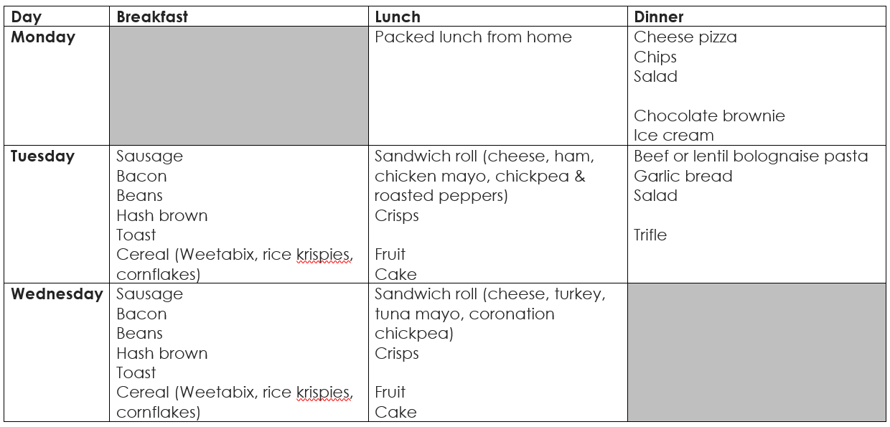
Sample menu

Slide 8
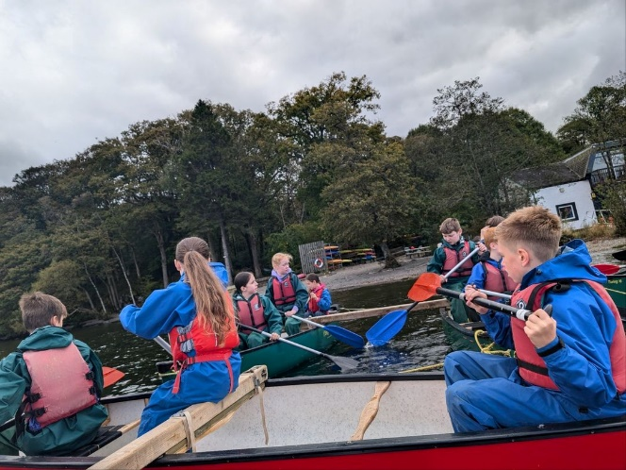
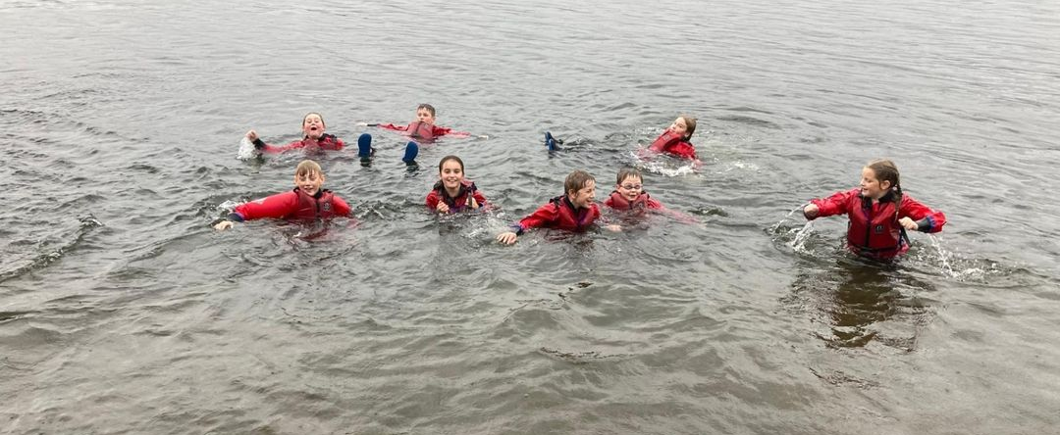
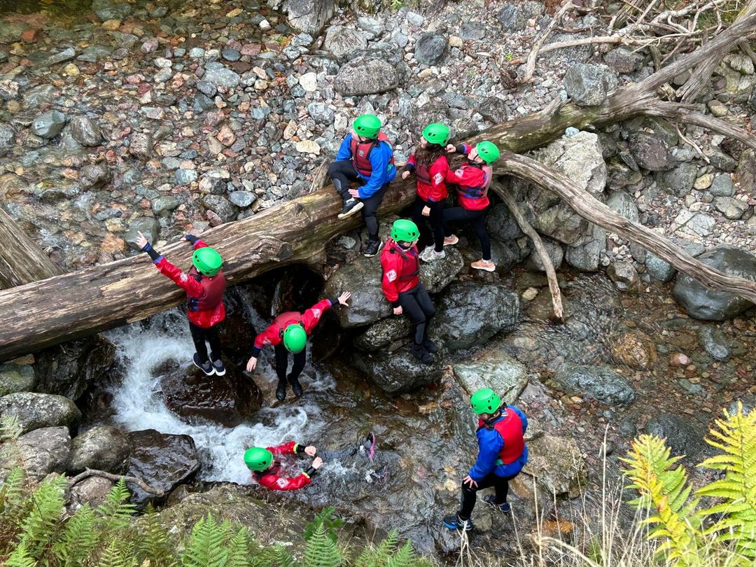
Activities
Tower Wood has an action-packed few days planned for the children. There will be a selection of activities such as:
Ghyll scrambling
Leap of faith
High ropes challenges
Crate stacking
Canoeing
Teambuilding
Evening activities
The children will have a safety briefing each morning and also before each activity. All safety equipment will be checked before the children begin any activity.

Slide 9
Kit List
Please refer to the kit list information provided by Tower Wood. All items of clothing should be clearly labelled with your child’s name and should fit into one piece of luggage (case or holdall). Packing a small clock or wrist watch might be an idea as children will have no idea of time in their rooms.
It is a good idea for your child to pack the bag with you so they are familiar with everything that is being packed. You may want to include a copy of the kit list to help them when they are re-packing their bag on the Wednesday that we leave.
Items not to bring include: any electronic devices, mobile phones, aerosol sprays

Slide 10
Snacks
The children can bring a small number of snacks but these are not allowed in the bedrooms at Tower Wood so they will be stored in our kitchenette. Please put these in a labelled bag/container. Please do not pack too many snacks.
There is a small souvenir shop on site – children can bring up to £5 (in coins) in a named purse or wallet.

Slide 11
Groups and Bedroom allocation
The children will be split into 4 groups to complete their activities during the day. Each group will have at least one member of St. Teresa’s staff and each activity will be led by a qualified instructor from Tower Wood.
The children will stay in these groups in the day but will have lots of opportunities to mix with the rest of the cohort throughout the stay and at meal times.
The bedrooms sleep between 2 - 6 children. They are all en-suite and have single and bunk beds. All bedding is provided. Children will need to make their own bed.

Slide 12
Groups and Bedroom allocation
St. Teresa’s staff bedrooms will be very close by and there will always be someone available throughout the night.
The children will be asked about friendship preferences for groups/bedrooms and they will be told their groups when we arrive at Tower Wood.

Slide 13
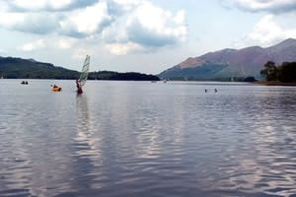
St. Teresa’s Staff
The following staff members will be accompanying the children on the trip:
Mrs Hawitt
Miss Jackson
Mrs Walsh
Mrs Brown

Slide 14
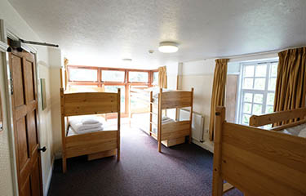
Any Questions?

